Slide 1
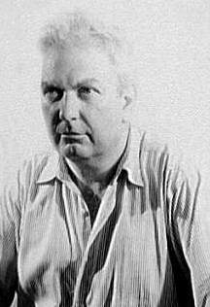
Alexander “Sandy” Calder
By Layla Renee Jones

Slide 2
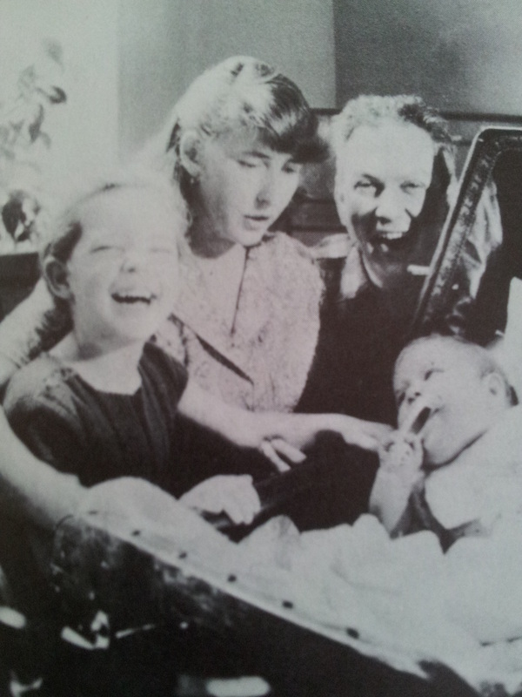
Intro to Alexander Calder
ALexander with wife and kids.
Alexander Calder is his full name, his nickname was “Sandy” though.
Sandy was born July 22, 1898. He died November 11, 1976.
Sandy was born in Lawnton, Pennsylvania. He died in New York City.
His mother was Nanette Calder, she was a painter. His father was Alexander Stirling Calder, he was a sculptor. Sandy’s grandfather Alexander Milne Calder was also a sculptor. As you can see Sandy came from a family of artists. Sandy had one sister named Margaret Calder Hayes.
Here are the sites I used for this slide:
https://www.britannica.com/biography/Alexander-Calder
https://en.wikipedia.org/wiki/Alexander_Calder
https://www.guggenheim.org/artwork/artist/alexander-calder

Slide 3
Later Life to Alexander Calder
Sandy at first didn’t go into the family business, which is art. Instead he got a degree in mechanical engineering.
Eventually in 1923 he went to study art and become an artist.
In 1926, Sandy published his first how to draw book. It was on how to draw animals.
Also in 1926 he went to England and Paris he stayed there until 1933. He did go back to the US many times though.
While there he created a lot of pieces of art, he also did his own show called Cirque Calder.
In 1931, Sandy married Louisa James, they had two kids and moved to New York in 1933.
Then he died November 11, 1976 at 78 years old.
Here is the site I used for this slide:
https://www.britannica.com/biography/Alexander-Calder/Mobiles-and-stabiles

Slide 4
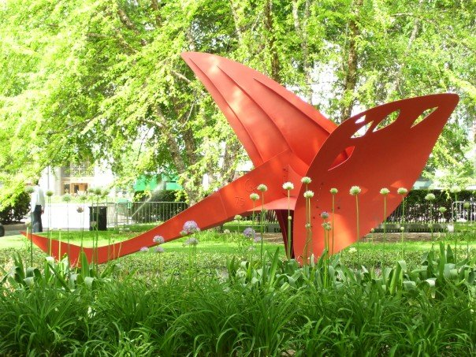
Flying Dragon
Sculpture made by Alexander Calder. He made this in 1975. The Flying Dragon was made out of steel.
Sites Used:
https://en.wikipedia.org/wiki/Flying_Dragon_(Calder)
https://www.revolvy.com/page/Flying-Dragon-%28 Calder%29

Slide 5
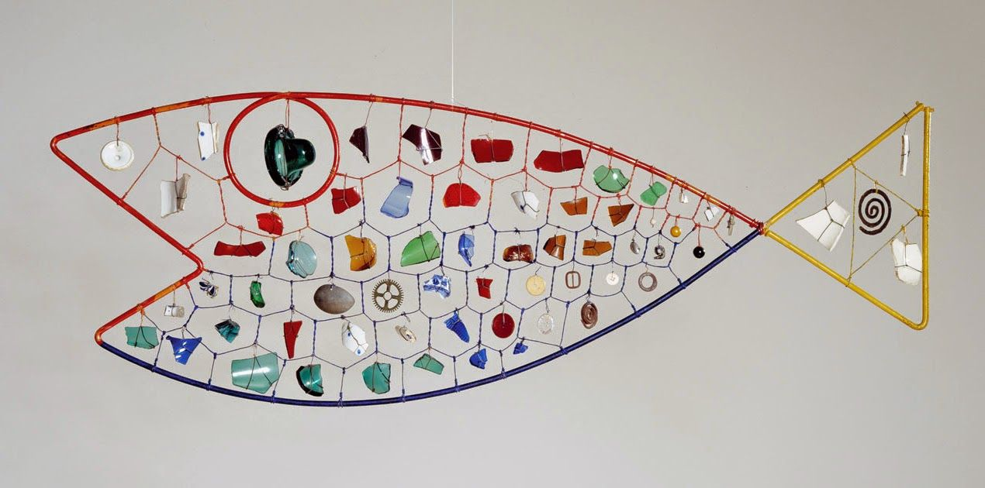
Sites Used:
https://www.nga.gov/collection/art-object-page.92734.html
Finny Fish
This is a mobile made by Alexander Calder. He made this one in 1948. This was made out of steel rods, steel wire, glass, and random objects.

Slide 6
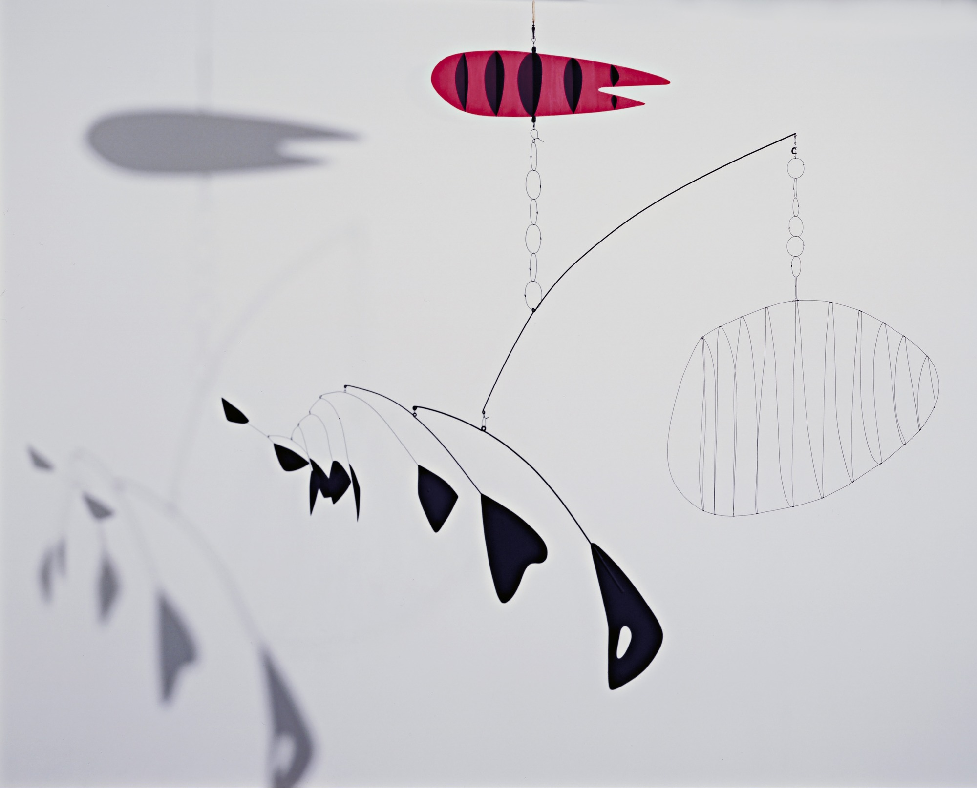
Lobster Trap and Fish Tail
This is another mobile made by Alexander Calder. It was made in 1939. He made this out of steel wire and aluminum sheet.
Sites Used:
https://www.coursehero.com/file/p13dkop/ALEXANDER-CALDER-LOBSTER-TRAP-AND-FISH-TAIL-Lobster-Trap-and-Fish-Tail-is-a/

Slide 7
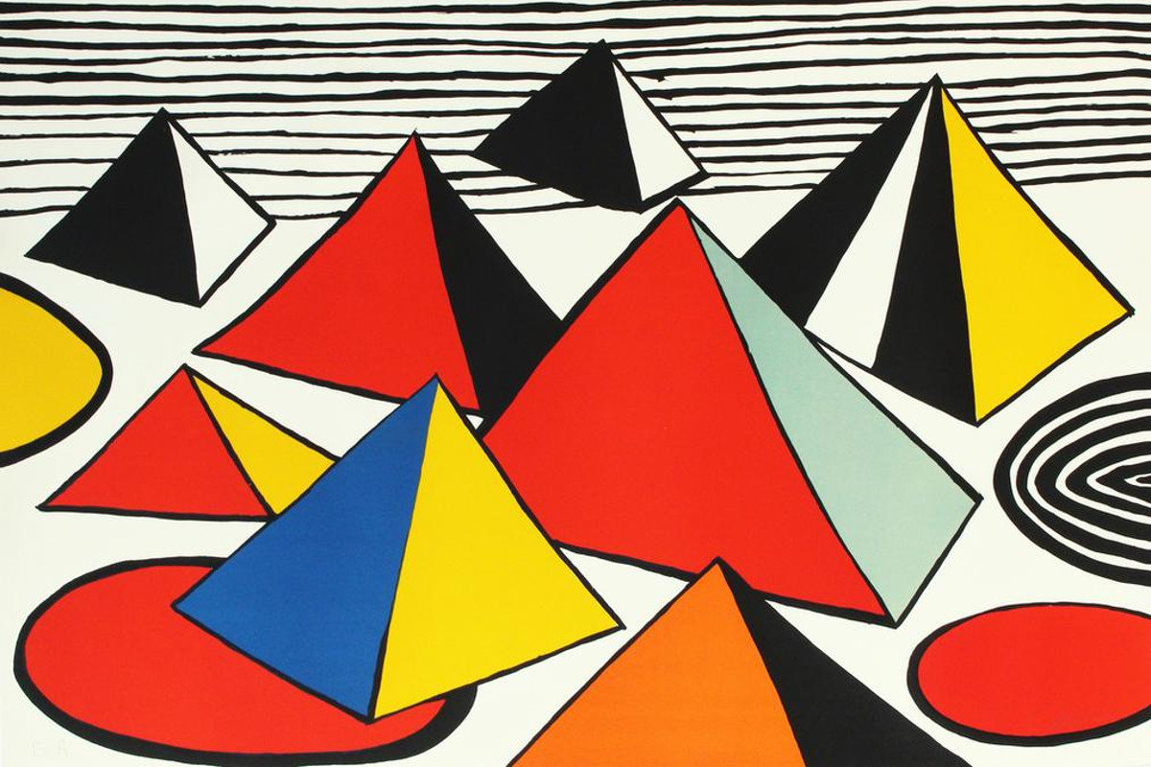
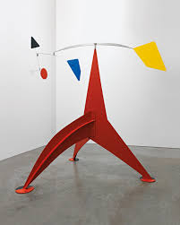
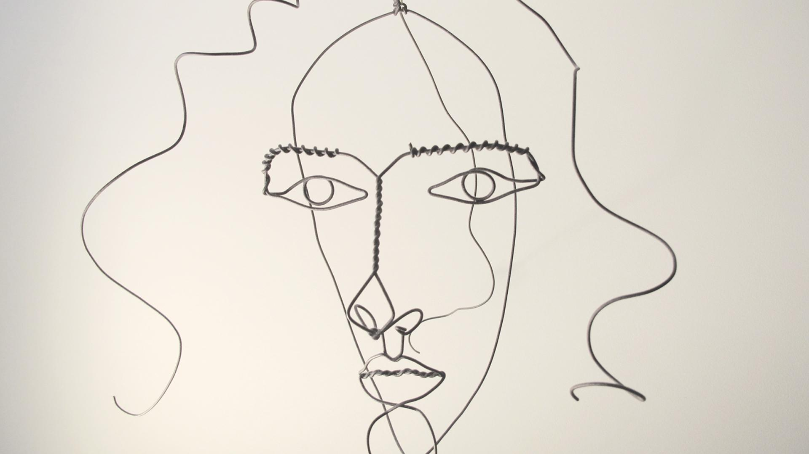
Style of Sandy’s Artwork
Sandy’s paintings are vibrant in color, yet very simple in design. His paintings can also be quite complex in understanding them. His mobiles would be enjoyable in person to see such strange shapes hanging in the air. Most of his sculptures are very bright in color and others of them are very exciting in shape and form. His wire sculptures are complex and confusing in design yet fun. In his art he used a lot of steel and wire.
For this slide I just looked at his artwork on google images to help me. I also used the link with the art adjectives on google classroom.

Slide 8
Opinion of his Artwork
My personal opinion of his artwork is, it's not really my favorite. I don’t really like any of his paintings because they are just super simple and it doesn't excite me. Most of his mobiles aren’t really my taste either because they are just random shapes. I do like the Finny Fish though, because I liked how he used everyday objects and colored glass and it was just so vibrant.
For this slide I just looked at his artwork on google images to help form my opinion of them. I also used the link for adjectives.

Slide 9
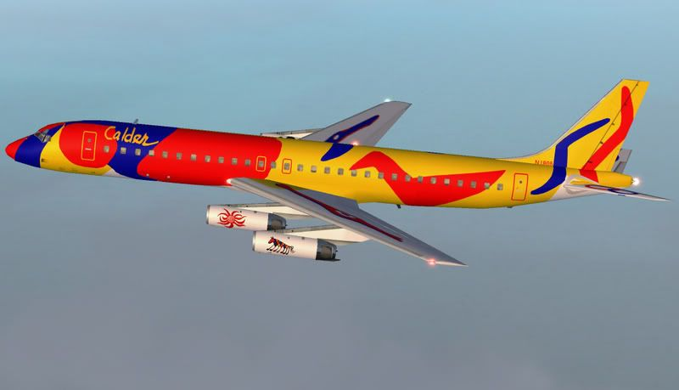
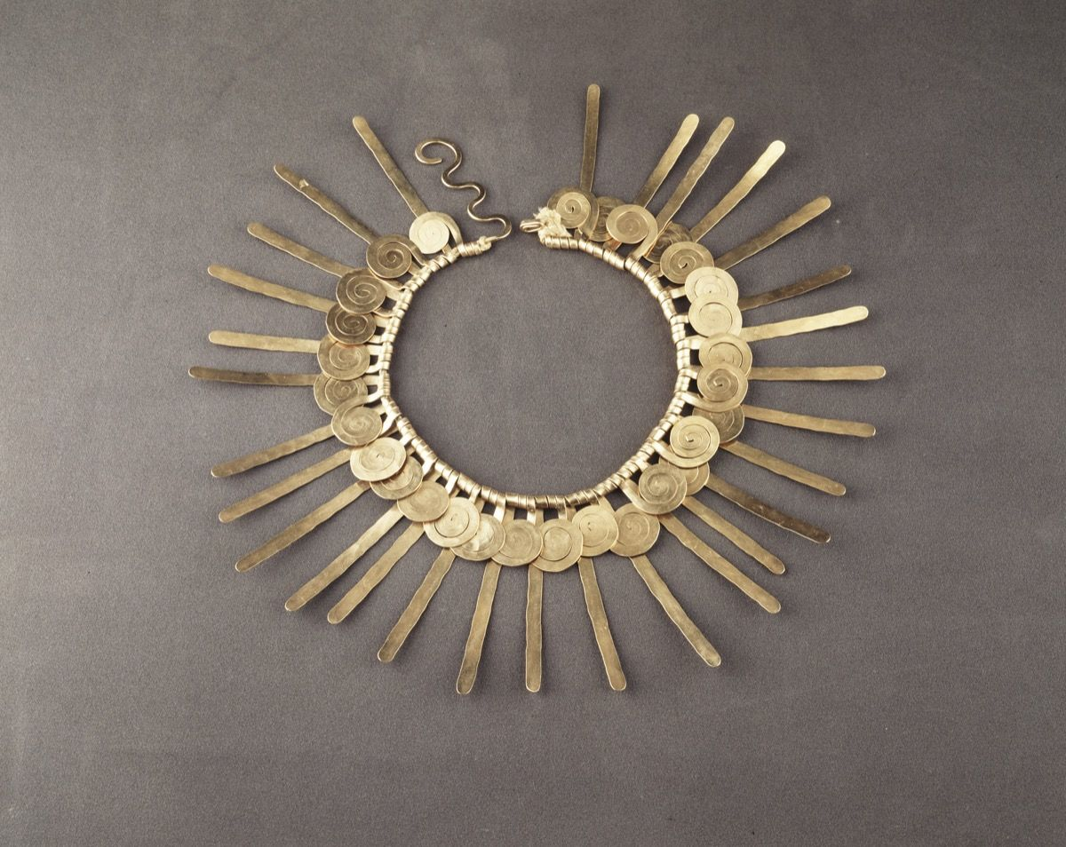
Fun Facts!!!!!!!!
Alexander’s abstract sculptures are inspired by things found in nature, such as petals and leaves.
Not only did he make sculptures, he also made jewelry and did printmaking.
He once was asked to decorate a jet and he did.
Site Used:
https://mymodernmet.com/alexander-calder-facts/

