Slide 1
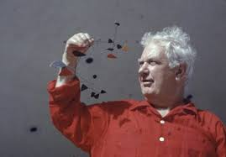
Alexander Calder
By: William Harvie
https://news.artnet.com/art-world/calder-first-biography-jed-perl-1125158

Slide 2
Alexander Calder is Born and Early Life
Alexander Calder was born on July 22, 1898.
He was born in Lawton, Pennsylvania, United States.
Nanette Calder, his mother, was a painter and Alexander Stirling Calder, his father, was a sculptor. His grandfather, Alexander Milne Calder, was also a sculptor. He also had a sister who was named Margaret Calder Hayes.
At first he did not want to go into the art business because he wanted to have a career in engineering. His father had to move for work so he later lived in Arizona, California, and New York.
In 1919, Calder received a degree in mechanical engineering after attending Stevens Institution of Technology in Hoboken, New Jersey.
https://www.britannica.com/biography/Alexander-Calder

Slide 3
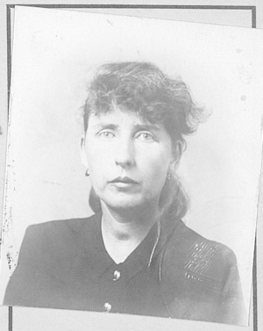
Later Life
https://www.wikitree.com/wiki/James-12108
Later, in 1923, Calder wanted to start studying art at the Art Students League in New York City. In 1926, he set up an art studio in Paris, France.
In his art studio he created 3D abstract sculptures out of wire that looked like birds, cows, elephants, horses, and some other animals.
He married Louisa James and they had two children named, Sandra and Mary Calder. They lived in New York City where Alexander Calder set up a few studios. His art was very ridiculous and childish. Critics said that these were very hard to take seriously. He died when he was 78, in 1976, in New York, NY.
https://www.britannica.com/biography/Alexander-Calder
This is Louisa James Calder, Alexander Calder's wife.

Slide 4
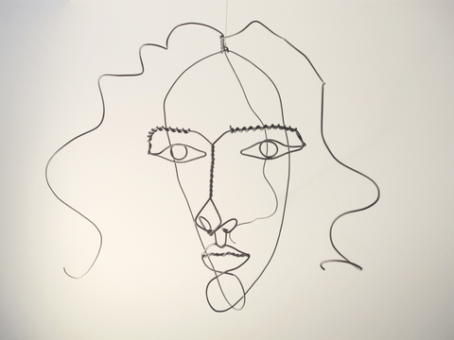
Medusa C.
This wire sculpture was made in 1930 by Alexander Calder. It is also made out of wire, which most of his art is.
The dimensions of the art is: 12 ¼’’ x 17 ¼’’ x 9 ½.’’
This is in the Calder Foundation, in New York.
http://www.calder.org/work/by-category/wire-sculpture

Slide 5
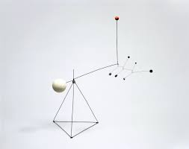
Small Feathers
This standing mobile was another piece of art that Calder made in 1931. The materials he used are wire, wood, lead, and paint.
The dimensions of this are: 38 ½’’ x 32’’ x 16.’’
This is also at the Calder Foundation in New York.
http://www.calder.org/work/by-category/wire-sculpture

Slide 6
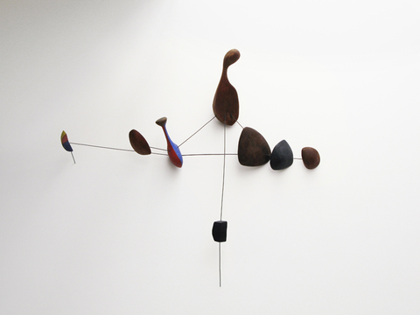
Wall Constellation with Row of Objects
This wall sculpture is another art that Alexander Calder made in 1943.
The materials used are wood, wire, and paint.
The dimensions are: 28’’ x 36’’ x 6’’
This is also in the Calder Foundation in New York.
http://www.calder.org/work/by-category/wire-sculpture

Slide 7
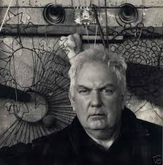
What do I think about Alexander Calder's art and style
What I think:
I think that Calder’s art is very empty and boring. I don’t like it because I can only look at the art for about 5 seconds before turning it away. This art seems very dark and creepy in a way.
Style:
His art is simple but it is sad, still and empty. It is also very dark and boring.
https://www.wikiart.org/en/alexander-calder

