Slide 1
Andy Warhol
By: Grace Bentley

Slide 2
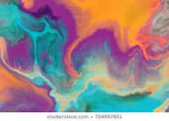
Dates of life
Andrew Warhola also known as Andy Warhol was born on August 6, 1928 in Pittsburgh, Pennsylvania.
Andy Warhol died on February 22, 1987 in the New York Hospital he was 58 years old.
He was recovering from a gallbladder surgery then he died in his sleep due to a sudden postoperative irregular heartbeat.

Slide 3
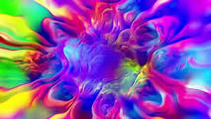
Family
Andy Warhol's parents were Julia Warhola and Andrej Warhola.
Andy was the youngest of three brothers Pavol and John Warhola.
He was never married and never had any kids but he had a nephew named James Warhola.

Slide 4
Education
Andy Warhol went to elementary at Holmes School.
Later he went to Schenley High School.
Andy Warhol went to college at Cornell University and graduated with a Bachelor of Fine Arts degree in 1949.

Slide 5
Health
Andy had Sydenham chorea which is a neurological disorder.
He had pigment issues which caused skin discoloration because of that he got nicknames like “Spot” and “Andy the Red-nosed Warhola”.
He wore wigs, unique clothing and cosmetics to look better.
He also had plastic surgery to change his nose shape.

Slide 6
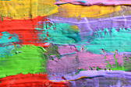
Shot
On June 3, 1968 Valerie Solanas shot Andy Warhol and Andy was briefly declared dead.
The two bullets from getting shot tore through Andy's stomach, liver, spleen, esophagus and both lungs.
The doctors were able to revive him.

Slide 7
Artistic Path
In 1949 he moved to New York City to get a job as a commercial artist.
That is when he changed his last name from Warhola to Warhol.
He got a job with Glamour magazine and went to become one of the most successful commercial artists of the 1950s.

Slide 8
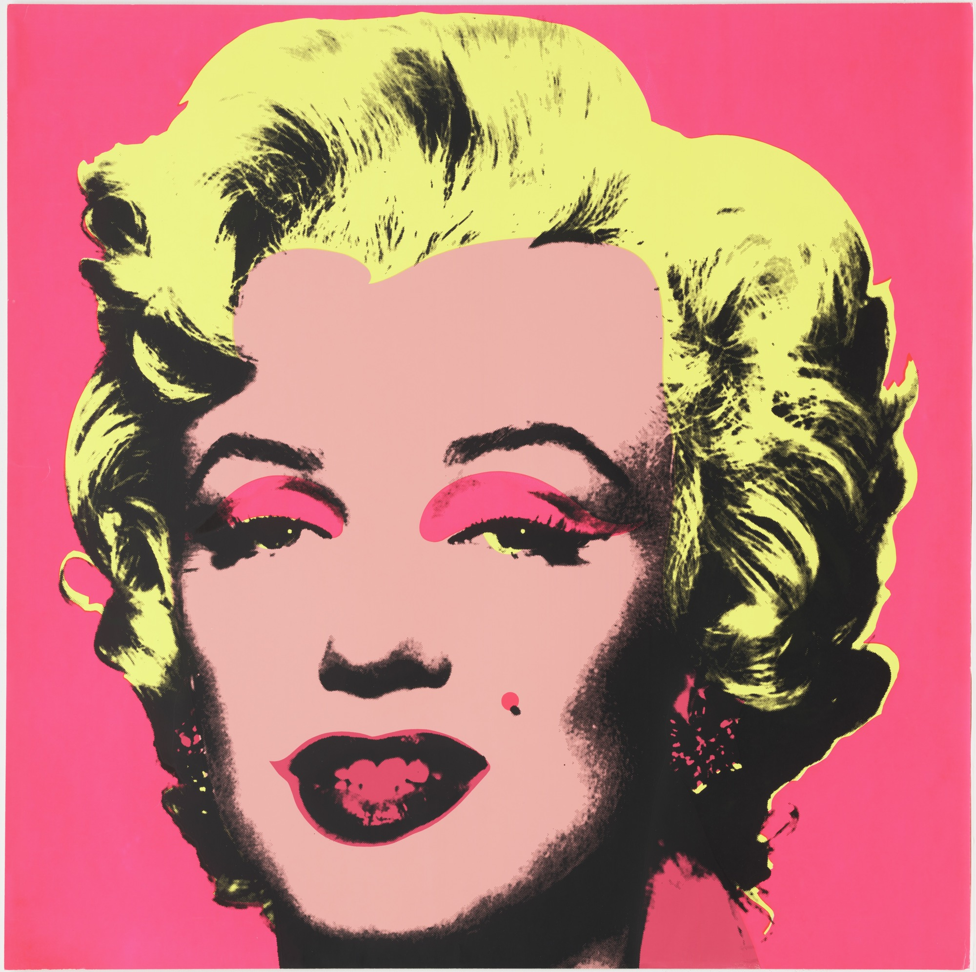
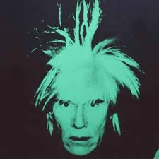
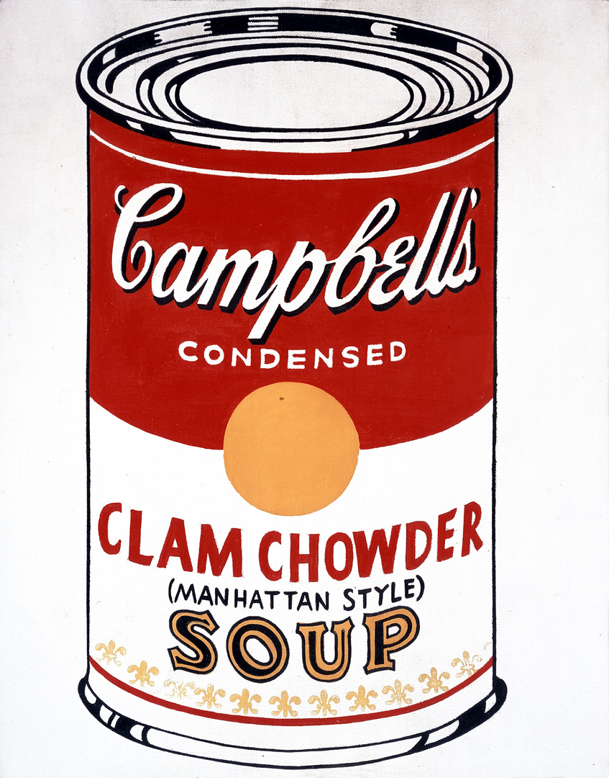
Andy Warhol created pop and modern art.
Marilyn Monroe
By: Andy Warhol in 1967
Andy Warhol's Campbell soup can
Andy Warhol Self Portrait

Slide 9
Art Supplies
Andy Warhol would use many different materials to produce his art such as…
Video, Sculpture, Photo Engraving and many more.
He used paint, ink and pen he really just used whatever he could find.
In 1962-1987 he used screen printing to make art.

Slide 10
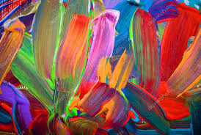
His Art
Andy Warhol’s art is bright, colorful, and happy.
His art is creative and vibrant.
I like his art, it makes me happy and the colors make his art pop.

Slide 11
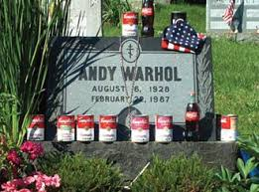
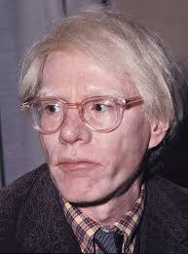
Andy Warhol's Tombstone
Andy Warhol

Slide 12
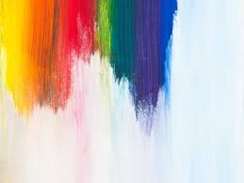
These are the sites I used...
https://en.wikipedia.org/wiki/Andy_Warhol
http://www.warhola.com/biography.html
https://www.warhol.org/andy-warhols-life/
https://www.biography.com/artist/andy-warhol
https://hamiltonselway.com/andy-warhols-silk-screening-process/
https://www.quora.com/What-did-Andy-Warhol-use-to-paint

