Slide 1
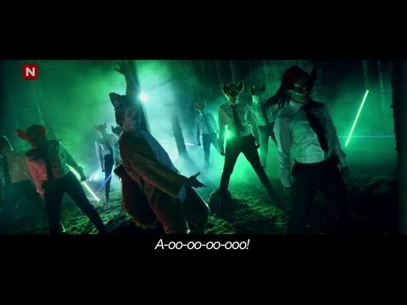

Slide 2
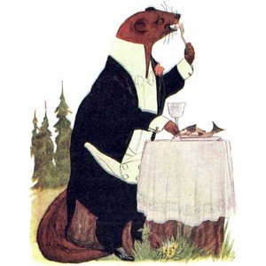
So...what does the fox say?
Name the various animals seen in the music video.
What does personification mean?
Write a sentence to personify this wild animal. (see if
You can make it rhyme)

Slide 3
Write a short story about this dog painted by Mrs. Clark’s friend Gerald Stephan.
Check out the post on our NMS art website about when Gerald visited the art room in 2014. http://coveredinpaintbraves.weebly.com
Also look in the 6th grade blog for some animals masks made by the current 8th graders.

Slide 4
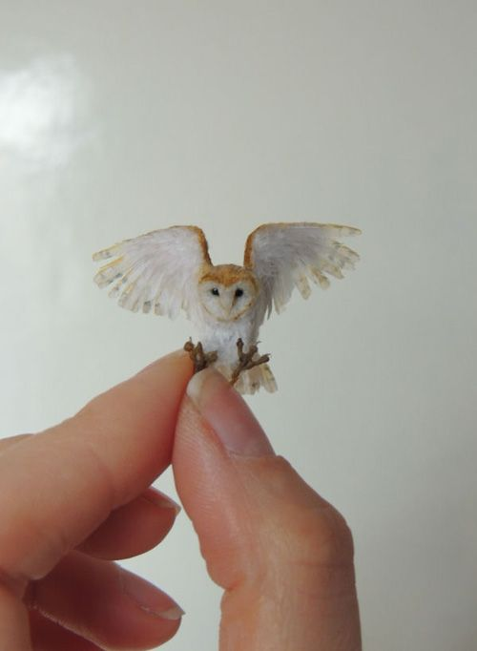
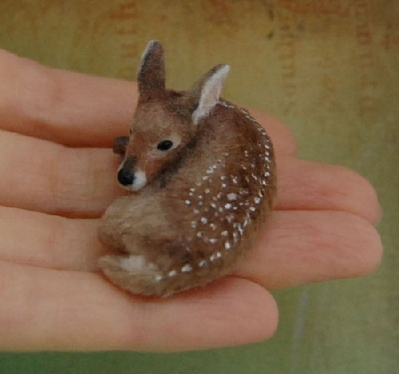
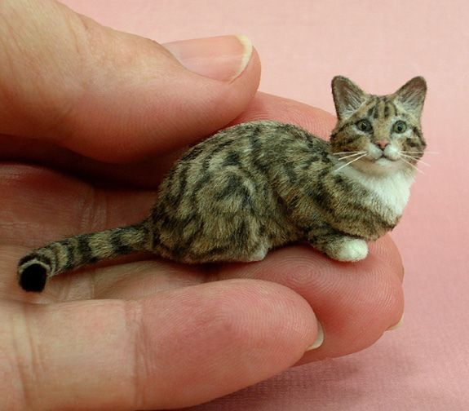
Mini Animal Sculptures
7th graders
What animal will you choose?
How will you personify this animal?

Slide 5
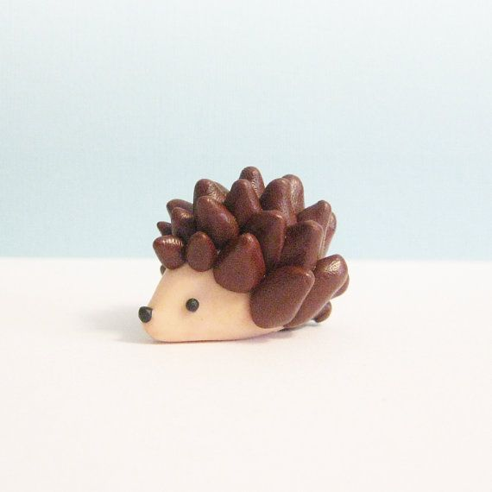
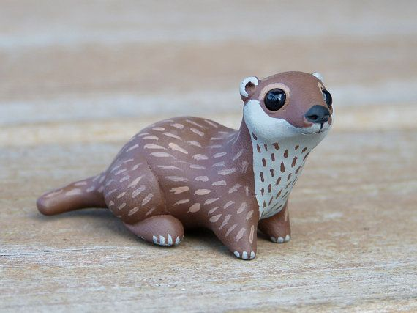
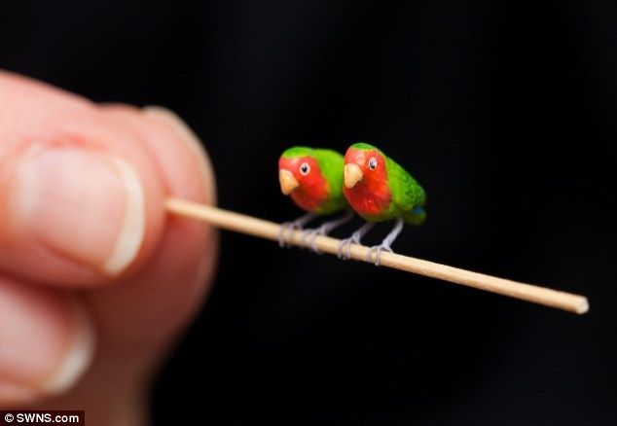
Building with Air Dry Clay

Slide 6
Steps:
Decide on your animal. Look up photos, draw the stance/ position of the animal you want to sculpt.
Write about how you will personify the animal.
Begin sculpting with the air dry clay to begin forming your animal.
Finish building, allow to dry, re-attach any loose parts and then paint your sculpture.
Write a short story about the personified animal.

Slide 7
You will use your spirit animal from your transformation project to create a 3-D mask for the animal.
Steps:
Use your transformation project to study the animal’s features.
Draw what you want your mask to look like.
Use mask forms, cardboard, tape, hot glue, foil, to create the armature. Make sure you find a new way to personify the animal.
Rip newspaper and mix paper mache to cover entire mask. (at least 4 layers)
Paint the mask and write a short story about who the animal is. (personify it)

Slide 8
Personified Animal Story:
Make sure to have the following details in your story:
Type of animal
Name of the animal
Description of the animal
How the animal is personified

