Slide 1
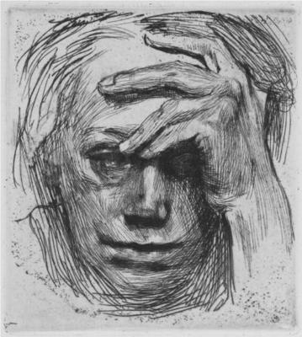
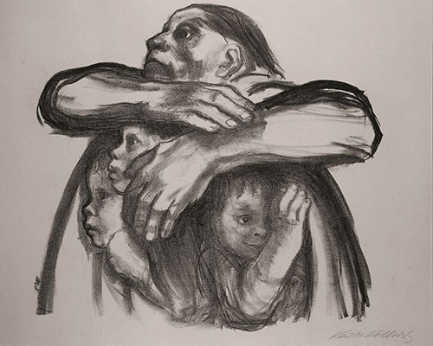
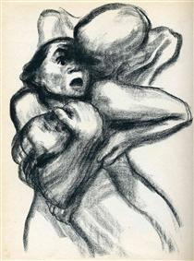
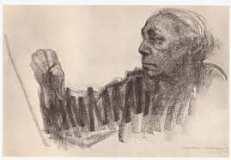
Kathe Kollwitz
By: Maddie Elliott

Slide 2
Background Information
-She lived from July 8, 1867- April 22, 1945. She died at age 78.
- She painted and built sculptures.
-She used mostly black, white, gray and sometimes color.
-Her maiden name was Shmidt.
-She asked her brother for is blessing for her to commit suicide, but he didn’t give her his blessing so she didn’t commit suicide.
britannica.com/biography/kathe-kollwitz https://www.theartstory.org/artist/kollwitz-kathe/life-and-legacy/

Slide 3
Where did she live?
-She was born and raised in Konigsberg, East Prussia.
-She later moved to Munich, Germany to study at the Women’s Art School.
-In 1874 they she married Karl Kollwitz and they moved to Berlin, Germany.
-Her final resting place was Zentralfriedhof Friedrichsfelde, Berlin, Germany.
britannica.com/biography/kathe-kollwitz

Slide 4
Family History
-She had 5 siblings.
-Her husband was Karl Kollwitz.
-Her parents were Katherine Schmidt and Karl Schmidt.
-She had 2 children. Their names are Peter and Hans Kollwitz.
theartstory.org/artist/kollwitz-kathe/life-and-legacy/

Slide 5
About Kollwitz’s Career
-Kathe’s career started in 1881 and ended in 1945 when she died of heart failure.
-Kollwitz worked in an industry with mostly men so it was challenging for her to get popular.
-She did woodcuts, sculptures, and etchings.
-Her art was meant to express pain and loneliness.
https://www.theartstory.org/artist/kollwitz-kathe/life-and-legacy/
http://www.artnet.com/artists/käthe-kollwitz/
https://www.britannica.com/biography/Kathe-Kollwitz

Slide 6
Death Seizing a Woman
This was drawn in 1934. I think it is a powerful picture, because it shows how terrified the woman looks. This symbolizes a mother and child being taken by death. Kollwitz used crayon lithograph on paper.
https://www.wikiart.org/en/kathe-kollwitz/not_detected_235995

Slide 7
Seed for the Planting Must not be Ground
This was sketched in 1942. It is also very emotional and dark. To me this looks like a mother protecting her children. I read this article that explains that this picture is supposed to be expressing Kollwitz’s frustration and pain. Kollwitz used lithograph method.
https://www.theartstory.org/artist/kollwitz-kathe/artworks/

Slide 8
Self-portrait
This art is soft and quiet. It is such a creative work. It looks as if Kollwitz’s etching is etching itself. The expression on her face is soft yet powerful expression. This etching is located in the National Gallery of Art, Washington,D.C. In this etching she used charcoal.
https://commons.wikimedia.org/wiki/File:Kathe_Kollwitz_-_Self-portrait_NGA_1943.3.5217.jpg

Slide 9
Self-portrait with hand on brow
In this portrait Kollwitz looks empty and alone. There is a lot of pain being expressed in this photo. I read on the website stated below that this portrait is expressing women in poverty. She used woodcut and drypoint for this piece of art.
https://ago.ca/exhibitions/kathe-kollwitz-art-and-life

Slide 10
THE
END

